Slide 1
Social Network Analysis
Graph Theory and Social Networks
Prof. Keeheon Lee
TA. Jaekeun Lee
010-5599-9411
agdal1125@gmail.com

Slide 2
Table of Contents
- Graphs
- Strong and Weak Ties
- Networks in their surrounding Contexts
- Positive and Negative Relationship

Slide 3
Graphs

Slide 4
Basic Definitions
Graph
  a way of specifying relationships among a collection of items
  consists of nodes and edges
  Node : object in a graph
  Edge : link that connect a pair of objects
Node
Edge
  Undirected Graph
  Directed Graph

Slide 5
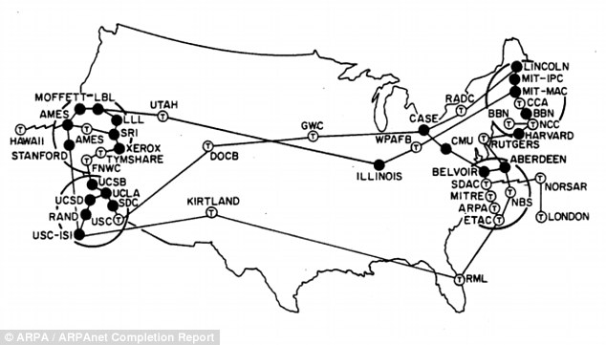
Basic Definitions
Graph
  serve as a mathematical models of network structures
  depending on its nodes and edges type of network differs
Network Types | Node | Edges
Communication Network | Computers or devices that relay messages | Direct links where messages can be transmitted
Social Network | People or group | Social interaction
Information Network | Information Resources (web pages, documents) | Logical connections (hyperlinks, citations, cross references
…. | ….
  Example of Communication Network
  <A network that depicts the sites on the Internet in its early days (1973)>
source : www.dailymail.uk

Slide 6
Paths and Connectivity
Path: sequence of nodes with the property that each consecutive pair in the sequence is connected by an edge ex) A, C , E , F
Cycle: “ring” structure. Path with at least three edges where first and last nodes are the same
ex) A-D-C , D-C-A, B-C-E-F-B
Connectivity: Graph is connected if, for every pair of nodes, there is a path between them
ex) In a Social Network, there might be two people who are isolated such as the graph below
A
B
C
D
E
G
H
F
I

Slide 7
Paths and Connectivity
Component ( Connected Component): Internally connected free standing “piece” of a graph
subset of nodes that fulfills two following conditions:
i) every node in the subset has a path to every other
ii) subset is not part of some larger set
ex) A-C-D is not a component (violates ii) / G-H is a component
Giant Component: - When a giant component exists, it is quite distinguishable
- It is an informal term for a connected component that contains
a significant fraction of all nodes.
ex) From the example graph, giant component may refer to
the big component that contains all nodes in the graph
except for G and H
A
B
C
D
E
G
H
F
I

Slide 8
Distance and Breadth-First-Search
A
Length: A path to be the number fo steps it contains from the beginning to the end
ex) Length of path “A-C-E-F-B” = 4
Distance: The length of the shortest path between the two nodes
ex) Distance from “A to E” = 2 ; A-C-E
Breadth-First Search: Most natural and efficient way to calculate distances in a large network data.
B
C
D
E
G
H
F
I
How to conduct Breath-First Search from “A to Z”:
1. Declare all of nodes that are at distance of 1 from A
2. From nodes found in 1, find all their linked nodes ( distance 2 from A)
* Do not include nodes that have been counted at least once
3. From nodes found in 2, find all their linked nodes ( distance 3 from A)
* Do not include nodes that have been counted at least once
(…) Continue until Z is found in the search.

Slide 9
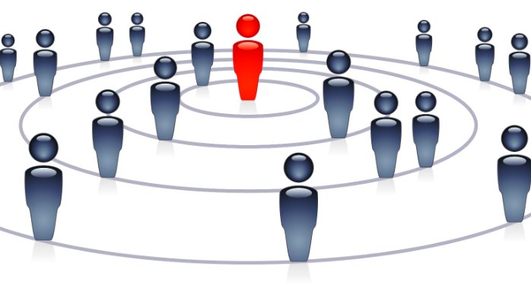
Distance and Breadth-First-Search
Small world phenomenon
We are often surprised to find unexpected people to be chained to our acquaintance,
just like the idiom: “It is a small world!”
This phenomenon is closely related to distance of human network.
Six Degrees of Sepration (John Guare’s play title)
  “ I read somewhere than everybody on this planet is separated by only six other people.
  Six degrees of separation. Between us and everyone else on this planet ”
Six Degrees of Kevin Bacon
Milgram’s Small world experiment

Slide 10
Strong and Weak Ties

Slide 11
Triadic Closure
Network can evolve over time. New edges and nodes can be generated. One of the most basic principal of predicting the change of network is Triadic closure.
Triadic Closure: effect of “closing” the last side of triangle
“If two people in the social network have a friend in common, then there is an increased likelihood that they will become friends themselves at some point in the future”
- Spread of Information through a population with socio-structural bias 1: Assumption of transitivity Anatole Rapoport –
ex) The formation of edge A – B , D – E, and B - F illustrates the effects of triadic closure
A
A
B
C
D
triadic closures
B
C
D
E
E
F
F

Slide 12
Triadic Closure
Clustering Coefficient (Local) :
Measurement to capture prevalence of triadic closure.
Probability that two randomly selected nodes connected to the observed node are connected to each other by edges.
Ranges from 0 (none of the connected nodes are also linked to each other) to 1 (all of the connected nodes are also linked to each other)
A
B
C
D
E
ex) Clustering Coefficient of Node C = $\frac{(A−D), (B−E)}{\left(A−B\right), \left(A−D\right), \left(A−E\right), \left(B−D\right), \left(B−E\right), (D−E)}=\frac{2}{4C2}=\frac{1}{3}$
F

Slide 13
Triadic Closure
The Reason for Triadic Closure:
1. Opportunity to meet increases
2. Mutual node gives a basis for trusting
3. Incentive-wise
A
A
B
C
D
triadic closures
B
C
D
E
E
F
F

Slide 14
The Strength of Weak Ties
Bridge: A particular edge that if deleted, it would cause the connected nodes to lie in different components
Local Bridge: A particular edge that if deleted, it would cause the connected nodes to have no mutual friends.
( the length of path between connected nodes will to become more than 2 )
Span of Local Bridge: distance of its end points(nodes) if the bridge is deleted
ex) Bridge = (2,3)
Local Bridge = (E, J), (F,M) , (G,M), (A, F)
Span of (E, J) , (F,M), (G,M), (A, F) = 7
5
A
F
M
G
4
3
2
1
B
C
D
H
K
I
6
E
J
Groups that are closely knitted together are likely to have similar information.
In this sense new information will, not always but unusually often, be provided through the bridge

Slide 15
The Strength of Weak Ties
Strength: In the links of social network, strong and weak relationships will co-exist. Thus, it is rational to
classify the links into strong ties, or weak ties. We can refer to this concept as: strength of relationship
Strong Triadic Closure Property: If edges (A,B) and (A,C) are strong ties, B and C are especially likely to form connection
① if a node A in a network satisfies the Strong Triadic Closure property, and is ② involved in at least two strong ties → contradiction occurs : Thus, local bridge should be a weak tie
Hence, weak ties are crucial connective structure for holding together disparate communities and keep global structure of the giant component intact
C
C
S
S
?
A
?
← Most likely to have an edge
A
?
S
S
B
B
This should be W

Slide 16
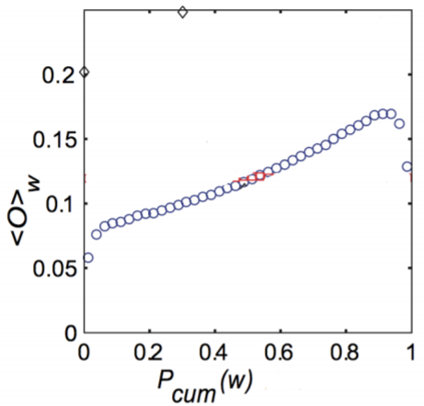
Tie Strength and Network Structure in Large-Scale Data
Neighborhood Overlap of edge A & B = $\frac{Number of Nodes who are neighbors of both A \& B}{Number of nodes who are neighbors of at least one of A or B (Except A and B )}$
*If neighborhood overlap = 0 → edge A&B is a local bridge. (Smaller the number, the edge will resemble a local bridge)
In an empirical result, neighborhood overlap of an edge depends on the strength of ties.
(Higher the strength, higher the neighborhood overlap value)
A plot of the neighborhood overlap of edges as a function of their percentile
in the sorted order of all edges by tie strength.

Slide 17
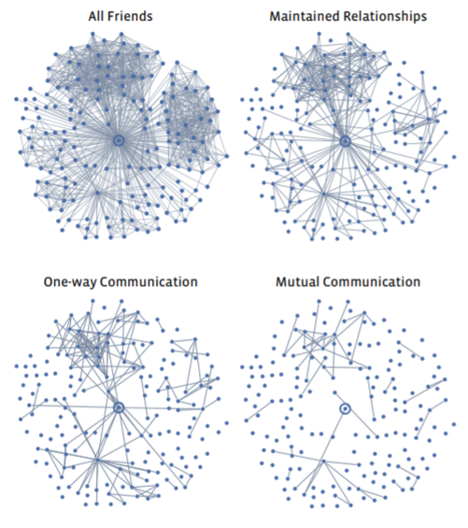
Tie Strength and Social Media
Facebook
All Friends: Facebook friendship
Maintained Relationships: users that followed other’s information
(regardless of actual communication)
One-way Communication: users that sent one or more messages to other
Mutual Communication: users that both sent messages to each other

Slide 18
Closure, Structural Holes and Social Capital
Embeddedness:
ex) Embeddedness of red line = 2 Embeddedness of yellow line = 0 (Local Bridge)
Property of an edge in a network that is calculated by number of common neighbors shared by the end points of the edge (equal to numerator in the ratio that defines neighborhood overlap)
Embeddedness = 0 → implies that the edge acts as an local bridge
A
G
B
If two individuals are connected by an embedded edge,
it is easier for them to trust on another and have confidence
in the integrity of the transaction or communications
A – B interaction is more credible than B – C , because A – B have mutual friends who will eventually be aware of the interaction of A – B. Possibility of social sanction and reputational consequences reinforce this.
D
C
K
I
B
A
J
E
L
M
N
O
P

Slide 19
Closure, Structural Holes and Social Capital
Structural Holes:
Having multiple local bridges, B spans a structural hole
(“empty space” in the network between two sets of nodes that do not otherwise interact closely)
B can act as a gatekeeper (power to access flows from group C and D belongs
B is able to access information that originates in multiple, non-interacting parts of the network
B can generate opportunities and create competitive advantage using its position
A
G
B
D
C
K
I
B
A
J
E
D
M
N
O
P

Slide 20
Closure, Structural Holes and Social Capital
Social Capital
Part of an array of different forms of capital, regardless of tangibility, that can be mobilized to accomplish tasks
“Physical capital (implements and technologies that help perform work) and human capital (individual people’s skills and talents)” - James Coleman
“Economic capital (Consisting of monetary and physical resources) and cultural capital (the accumulated resources of a culture that exist at a level beyond any one individual’s social circle, conveyed through education and other broad social institutions)” – Pierre Bourdieu
“Dichotomy between bonding capital and bridging capital” – Robert Putnam
“Tension between closure and brokerage” – Ronald Burt
Social Capital is a balance between benefits of triadic closure and embedded edges, and broker interactions at the interface between different groups across structural holes.

Slide 21
Betweenness Measures and Graph Partitioning
Graph Partitioning: a method that breaks network down into a set of tightly knitted regions, with sparser interconnections between the regions
Divisive method: identifying and removing “spanning links” between densely connected regions
Agglomerative method: assembling regions by focusing on the most tightly-knit parts of the network.
1
10
1
10
2
3
11
2
3
11
7
Graph Partitioning
7
8
8
5
9
12
5
9
12
14
14
4
6
13
4
6
13

Slide 22
Betweenness Measures and Graph Partitioning
Local bridges are important because they form part of the shortest path between pairs of nodes in different parts of the network. In short, they lie frequently in the shortest path between nodes. The abstract notion of “traffic” is defined by the concept betweenness.
Betweenness: total amount of flow that an edge carries, taking into account of all pairs of nodes using the edge
ex) Betweenness of 5 – 6 edge: Node group (1,2,3,4,5) and (6,7,8,9,10) has to go through 5 – 6 edge to reach each other
Thus, 5 x 5 = 25
Betweenness of 6 – 9 edge: Node group (1,2,3,4,5,6) has to go through 6 – 9 edge to reach node 10
Thus, 6 x 1 = 6
10
2
3
9
10
5
6
1
4
8
7

Slide 23
Betweenness Measures and Graph Partitioning
Girvan – Newman Method: Graph Partitioning by successive deletion of edges of high betweenness
1. Find the edge or multiple edges of highest betweenness and remove them
2. Re-calculate the betweenness and again, remove the edge or edges of the highest betweenness
3. Repeat step 1 and step 2, as long as edges remain in the graph.
10
1
10
1
10
1
2
3
11
2
3
11
2
3
11
7
8
7
8
7
8
5
9
5
9
12
5
9
12
14
12
14
14
4
6
13
4
6
13
4
6
13
1
10
2
3
11
7
8
5
9
12
14
4
6
13

Slide 24
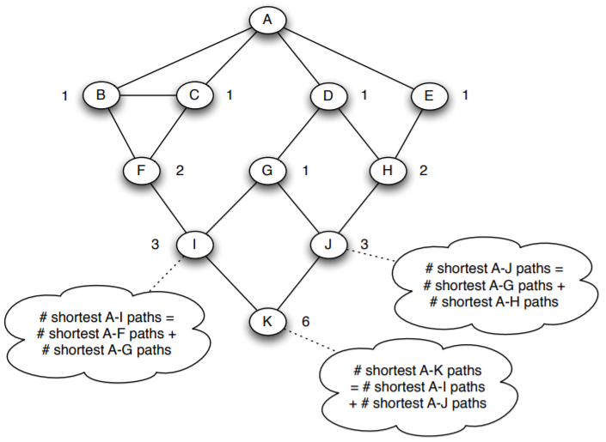
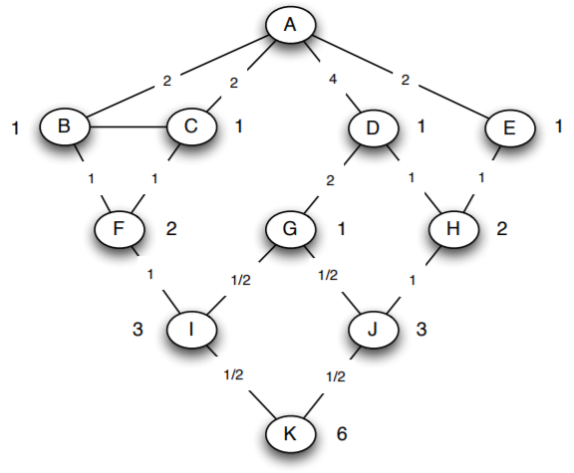

Betweenness Measures and Graph Partitioning
Efficient way of Computing Betweenness Values
Perform a breadth-first search of the graph, starting at appropriate point (Let’s say A)
Determine the number of shortest paths from A to each other node
Based on these numbers, determine the amount of flow from A to all other nodes that use each edge
step2
step3
Divide the total flow by the proportion of
# of shortest paths
Flow passing through F
= Flow destined to I (1)
+ Flow destined to F (1)
= 2
Flow passing through I
= Flow destined to K ($\frac{1}{2}$)
+ Flow destined to I (1)
= $\frac{3}{2}$

Slide 25
Networks in their Surrounding Contexts

Slide 26
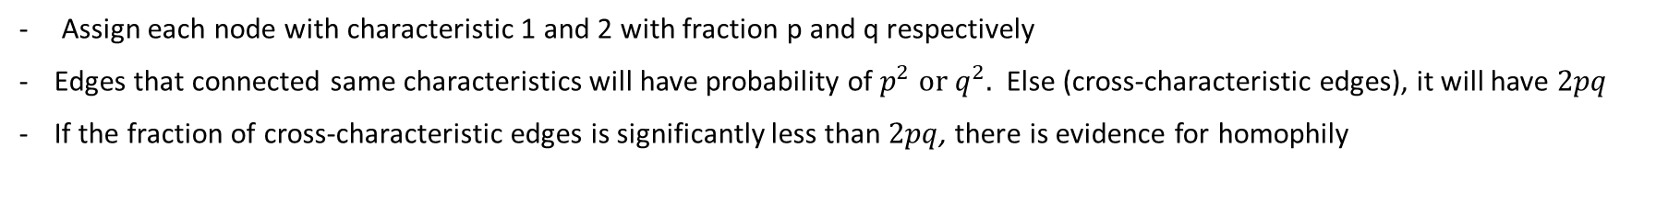
Networks in Their Surrounding Contexts
The contexts where a social network is embedded will generally have significant effects on its structure and the way it evolves over time. Each individual’s characteristics will influence forming of links. Thus, surrounding contexts affecting a network’s formation should be considered
Homophily
Links in social network tend to connect people who are similar to one another
Relevant to Triadic Closure
Measuring Homophily – Homophily Test for 2 characteristics
Assign each node with characteristic 1 and 2 with fraction p and q respectively
Edges that connected same characteristics will have probability of $p^{2} or{ q}^{2}.$ Else (cross-characteristic edges), it will have $2pq$
If the fraction of cross-characteristic edges is significantly less than $2pq$, there is evidence for homophily
Inverse Homophily
There are more heterogeneous edges
Marital, romantic relationships (significantly more than 2pq)

Slide 27
Selection and Social Influence
Selection
Immutable characteristics that promotes preferential ties among similar people (race, ethnicity)
Selection may operate at several different scales and different levels of intentionality and can be implicit
Social Influence, Socialization
Reverse of Selection; existing links in the network serve to shape people’s (mutable) characteristics
People may modify their behaviors to bring them more closely into alignment with behaviors of their friends
Interplay of Selection and Social Influence
Seeing the relative contributions of selection and social influence - longitudinal studies of a social network

Slide 28
Affiliation
Foci
Focal points of social interaction that constitutes social, psychological, legal, or physical entities around which joint activities are organized.
Refers to set of activities that people shares and takes apart
Affiliation Network
Network that represents each person and each focus as nodes and participation as edges
Network that represents the affiliation of people with foci.
Example of a class of graphs called bipartite graphs
(graph that has two sets of nodes and the edges do not connect to the nodes that belong to same sets)
Anna
Amazon
Mike
Google
John
Ebay
Daniel

Slide 29
Affiliation
Social Affiliation Network
Network that extends the notion of affiliation network to social network
There are two sets of nodes and edges
From the affiliation network, additional set of edges are introduced which represents social relationship
Mike
Amazon
Claire
John
Google
Daniel

Slide 30
Affiliation
Social Affiliation Network – Closure Processes
B
B
B
C
C
C
A
A
A
Triadic Closure
Focal Closure
Membership Closure

Slide 31
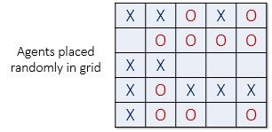
Spatial Model of Segregation
The Schelling Model - a famous model introduced by Thomas Schelling that shows how global
patterns of spatial segregation can arise from the effect of homophily
operating at a local level.
Representation
A population of individuals, or unit is called agents
Agents are in two types of immutable characteristics: O or X
Agents are contained in the cells of the grid
Cell’s neighbors are the cells that touch it (including diagonal)
Rule
If an agent in a cell discovers that fewer that t of its neighbors are of the same type of itself, it has an interest in moving to a new cell.
http://nifty.stanford.edu/2014/mccown-schelling-model-segregation/

Slide 32
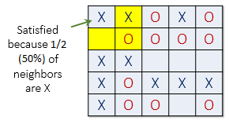
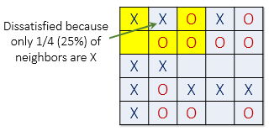
Spatial Model of Segregation
The Schelling Model of t = 50%
Each round, unsatisfied agents will move* into an unoccupied cells, until every cells are satisfied.
*The rule of movement has variations

Slide 33
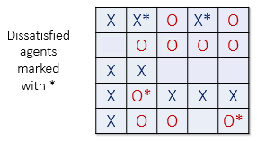
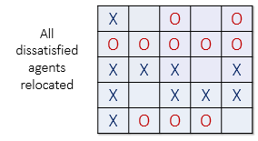
Spatial Model of Segregation
The Schelling Model of t = 50%

Slide 34
Positive and Negative Relationships

Slide 35
Structural Balance
Triangles with 1 or 3 “+”s are balanced, since they are free of instability*.
Triangles with 0 or 2 “+”s are unbalanced**.
A
A
** The case of (C) and (D) have psychological “stress” or “instability” into relationships.
+
+
+
+
* The case of (A) and (C) are natural, where the three are close friends
(A)
(B)
B
C
B
C
+
-
For case (C), either A would force the two friends B and C to get along together, or A would side up with one of B and C and turn against the other.
A
A
-
-
-
-
For case (D), there will be forces that motivates two of the three people to “team up” against the third
(C)
(D)
B
C
+ : The two nodes are friends
B
C
+
- : The two nodes are enemies
-

Slide 36
Structural Balance
Structural Balance Property
For every set of three nodes, if we consider the three edges connecting them, either all three or these edges are labeled “+” or exactly one of them is labeled “+”
A
A
+
+
-
-
-
-
B
B
-
-
+
+
C
+
D
C
-
D
Balanced
Not Balanced

Slide 37
Structural Balance
The Balance Theorem
If a labeled complete graph is balanced, then either all pairs of nodes are friends or else the nodes can be divided into two groups, X and Y. Each pair of people in X likes each other, each pair of people in Y likes each other, and everyone is X is the enemy of everyone in Y
Application of Structural Balance
The structural balance can be applied to trust, distrust, online ratings and international relations. The positive and negative relationships work is important for understanding the role they play on Social Websites, where users register subjective evaluations of each other.

Slide 38
Structural Balance
Weak Structural Balance Property
There is no set of three nodes such that the edges among them consist of exactly two positive edges and one negative edge
Characterization of Weakly Balanced Networks
If a labeled complete graph is balanced, then either all pairs of nodes are friends or else the nodes can be divided groups in such a way that every two nodes belonging to the same group are friends and every two nodes belonging to different groups are enemies.

